Slide 1

Study on Rental Properties Across Hyderabad
Presented By :
Sravanthi Sadineni
Farhan Khan

Slide 2
About me
Sravanthi Sadineni
- Masters (Business Analytics)
- As an electrical engineering student, I have always been passionate about technology and its applications. During my last semester of undergraduate studies, I had a course on data science which sparked my interest in this field.
- Pursuing data science will give me a competitive edge in the job market and enable me to contribute to innovative projects that require a multi-disciplinary approach.
- Linkedin - linkedin.com/in/sravanthi-sadineni
- GitHub - https://github.com/sadineni30
Farhan Khan
B.Tech (ECE)
In my current role, I have often encountered situations where data analysis could significantly enhance our operations, from improving project timelines to optimizing resource allocation. These experiences have sparked my interest in data science, and I have come to realize that the ability to analyze and interpret complex datasets is crucial in today’s technology-driven world.
Assistant Manager - Simfoni
Linkedin – www.linkedin.com/in/farhan-khan-60a6191b1
GitHub - https://github.com/farhankhanofficialid123

Slide 3

PROBLEM STATEMENT
Problem Statement
Price and Availability Analysis on Rental Properties in Hyderabad listed on Makaan Website.
OBJECTIVE
Highlight differences in rental prices and property types between various areas.
Identify current rental price trends and availability across different neighborhoods in Hyderabad.

Slide 4







WEB SCRAPING :
Web scraping is a process of extracting data or information from websites.
Website – Makaan - Makaan is an online real estate platform in India for buying, selling, and renting properties.
All the libraries listed above are used for Scraping and Analysis of the Data.

Slide 5
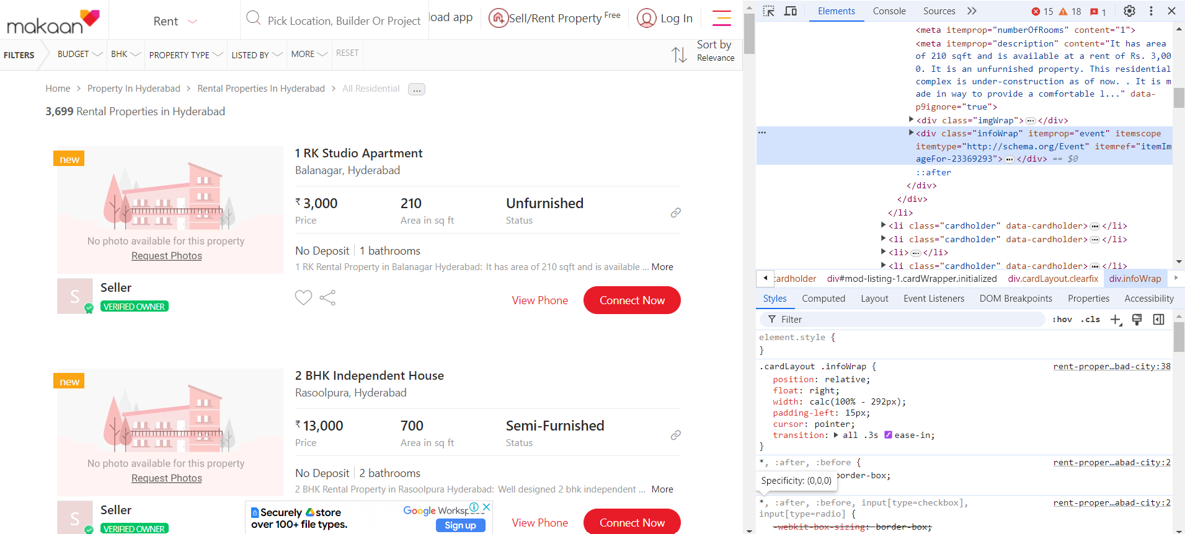
Website Interface with HTML

Slide 6
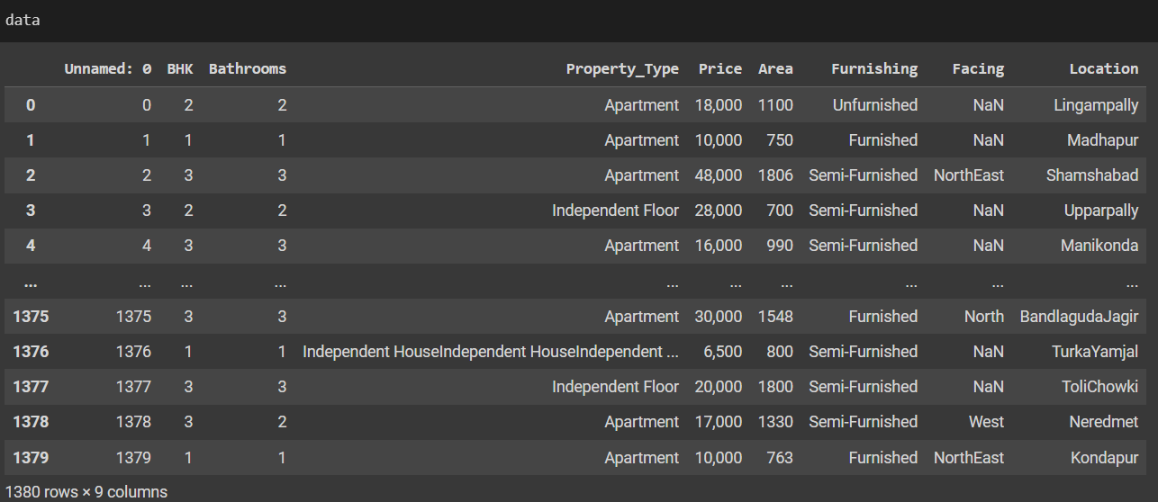
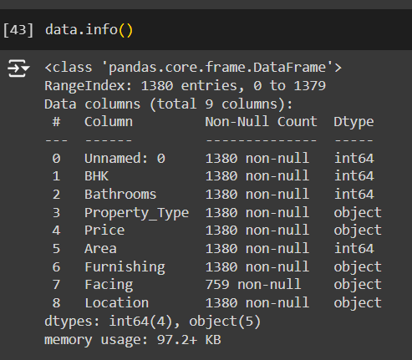
Raw Data
Raw data comprises of 1380 rows and 9 columns

Slide 7
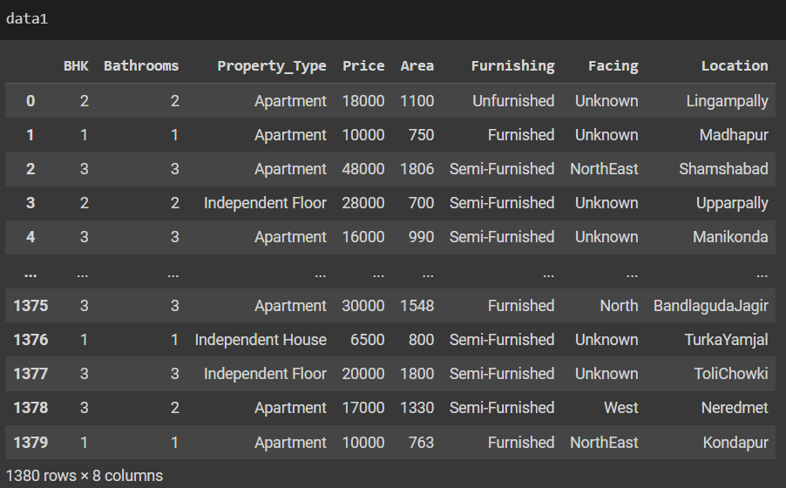
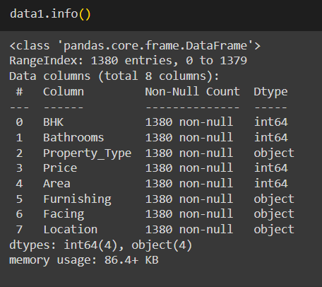
Cleaned Data
Cleaned data comprises of 1380 rows and 8 columns.

Slide 8
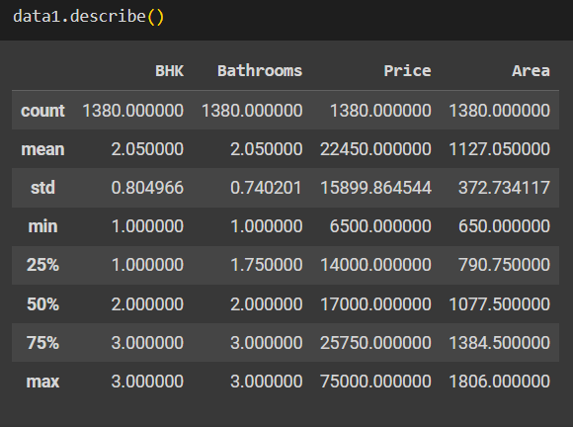
Data Exploration

Slide 9
Data Cleaning and Manipulation Steps
Data Cleaning :
Handling missing values in 'Facing' column
Handling null values in 'Price' column
Type conversion for 'Price' column
Standardizing values in 'Property_Type' column
Standardizing values in 'Facing' column
Data Manipulation:
Filling null values
Replacing incorrect values
Changing data type

Slide 10
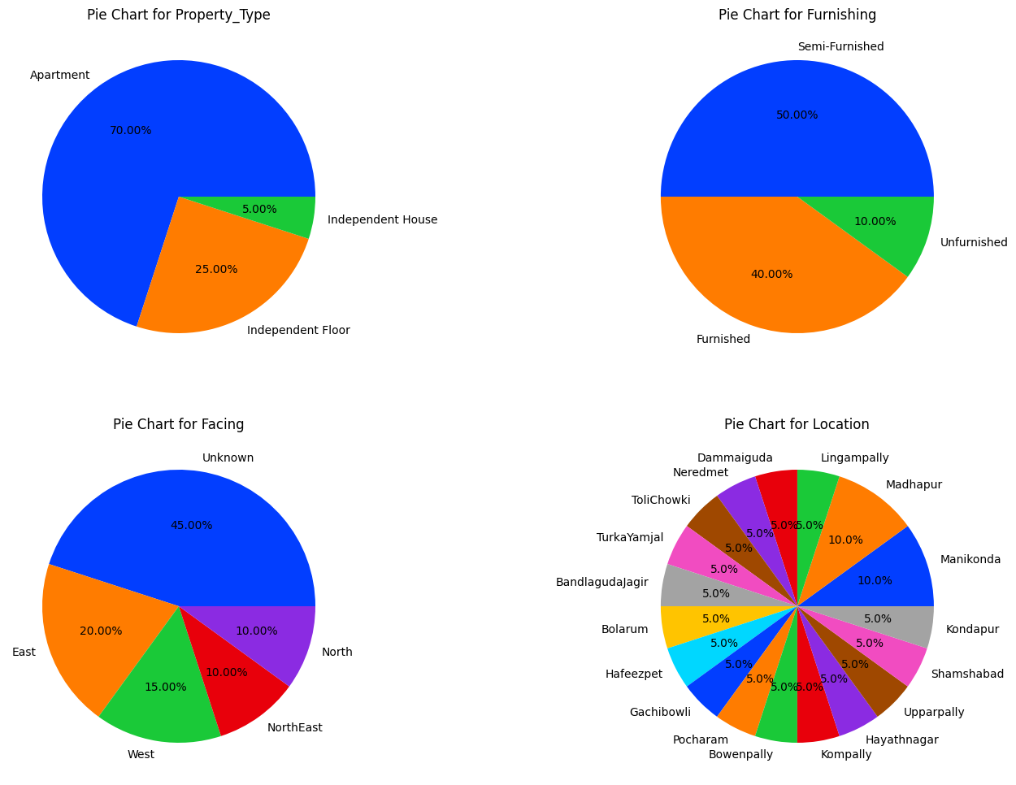
Distribution of Properties Location wise Across Hyderabad
Insights:
This pie chart represents the distribution of Properties area wise across Hyderabad.
We have 20.0% of properties across Manikonda And Madhapur area.
Rest all the areas have 5.0% distribution of properties.

Slide 11
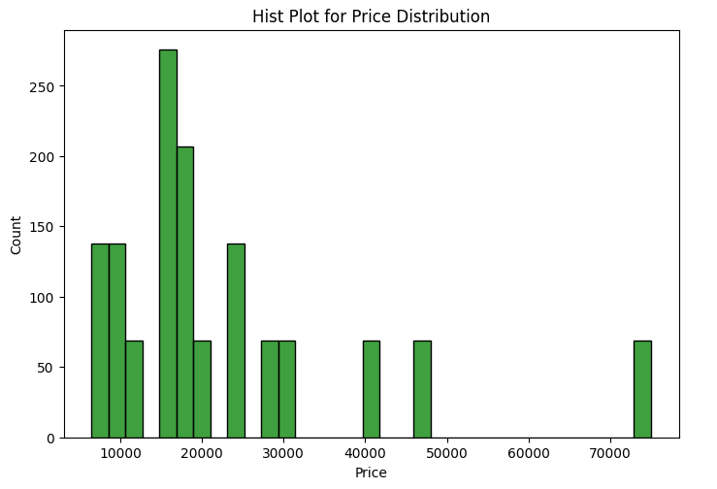
Distribution of Properties Price wise Across Hyderabad
Insights:
This histogram plot represents the distribution of Properties price wise across Hyderabad.
Maximum no of properties lies between the range 10K-30K INR.
Maximum price of a property lies between range 50k - 70K INR.

Slide 12
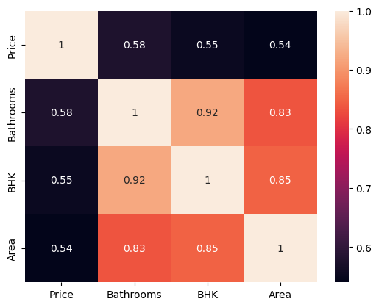
Correlation HeatMap
Insights:
Area have low to medium impact on price variation.
Number of bedrooms have low to medium impact on price variation.
Number of bathrooms have low to medium impact on price variation.

Slide 13
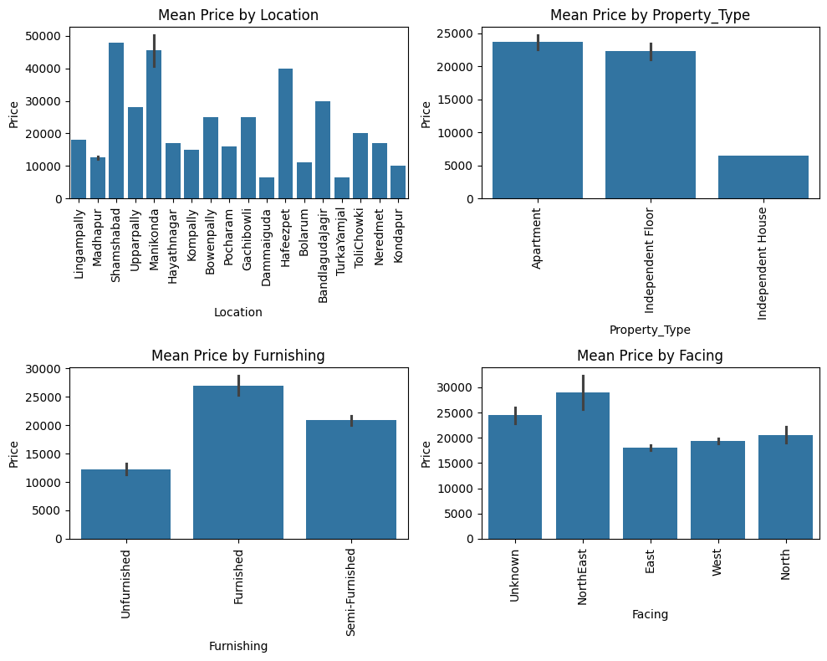
Price Variation Based on Categorical columns
Insights:
This bar graph represents the price variations based on categorical columns.
The first graphs tells us that Manikonda,Shamshabad,Hafeezpet has high average rental prices.
Average rent is low for Independent House compared to other type of properties.
There are not much price variations between Semi-Furnished and Unfurnished properties but furnished have more price than Semi-Furnished properties.
NorthEast facing house have high price , that means NorthEast facing properties are in demand.

Slide 14
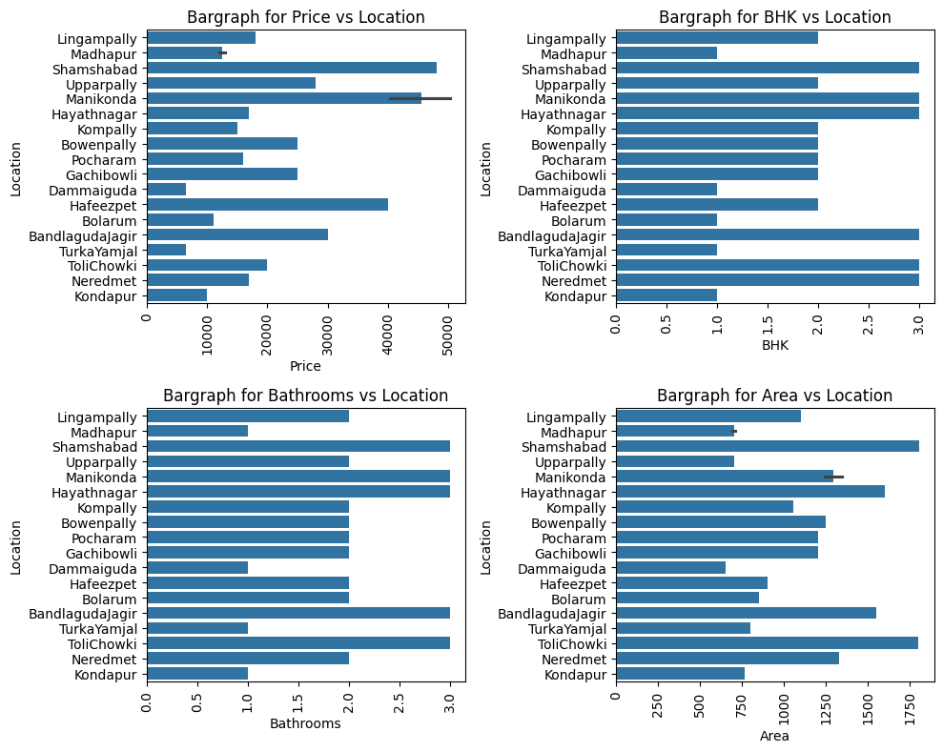
Availability Analysis Based on Numerical columns
Insights:
This bar graph represents availability analysis based on numerical columns.
The first graphs tells us that Manikonda,Shamshabad,Hafeezpet has high average rental prices.
We have Almost equal number 1,2 and 3 BHK Properties listed.
Most of the properties have more than 1 bathroom.
In most of the areas properties listed are in
the range 800-1250 sqft except that of
shamshabad,Himayat
Nagar,Tolichowki,Bandlaguda Jagir. They lies in
the range 1500 - 1800 sqft.

Slide 15
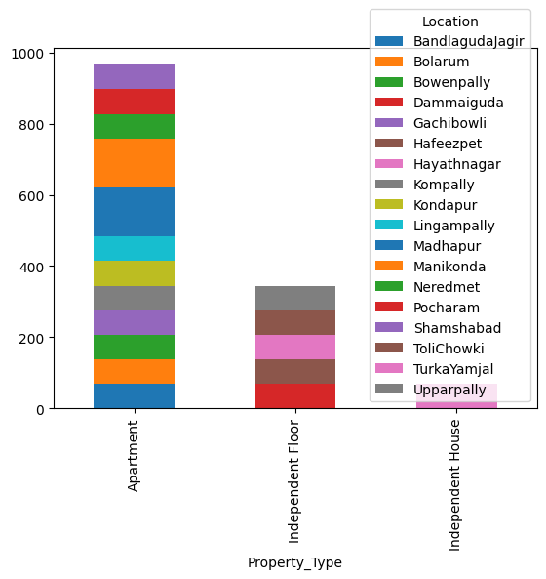
Property Type Distribution Location wise across Hyderabad
Insights:
This bar plot represents the distribution of Property type vs Location across Hyderabad.
Independent Houses are available only in Turkayamjal.
Independent Floor are available in Tolichowki,Hafeezpet,Hayath nagar, Dammaiguda and Upparpally.
Rest of locations have Apartments available.

Slide 16
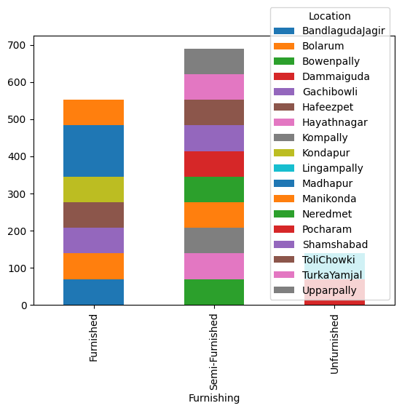
Furnishing Distribution Location wise across Hyderabad
Insights:
This bar plot represents the distribution of Furnishing vs Location across Hyderabad.
Maximum no of properties are semi-furnished.
Unfurnished properties are available only in Lingampally and Pocharam Location.
Maximum no of furnished properties are available in Madhapur location.

Slide 17
Key Business Questions
What types of properties (apartments, villas, independent houses) are most commonly available for rent?
Apartments are most commonly available for rent.
How do rental prices vary between different types of properties?
Rental price for Apartment are high when compared to other type of properties.
What is the total count of Rental Properties listed as per makaan?
There are total of 5340 rental properties listed in Hyderabad as per Makaan website.
Which localities have the highest rental prices listed on makaan?
Manikonda,Shamshabad,Hafeezpet has high average rental prices.
Which location have the most listings?
Manikonda And Madhapur have the most listings on makaan.

Slide 18
CONCLUSION
Price is not getting mostly affected by the any features.
In some areas, listings are limited to 1 bedroom and Apartments only.
More number listings are in Manikonda And Madhapur. It might be because of the IT Sector.
More number of listings lies in the range 10K-30K INR rental price.
Furnishing have very less impact on price.

Slide 19
Questions & Answers

Slide 20

THANK YOU

